Slide 1
Java From Functions to Objects
Università di Modena e Reggio Emilia
Prof. Nicola Bicocchi (nicola.bicocchi@unimore.it)

Slide 2
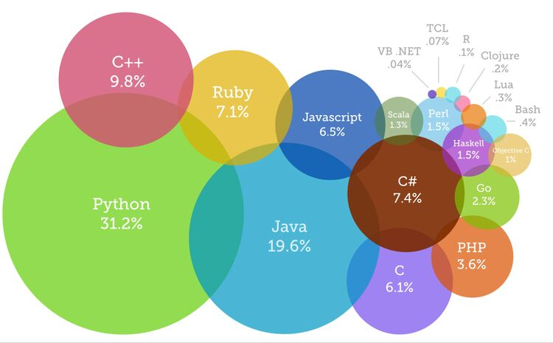
The Present

Slide 3
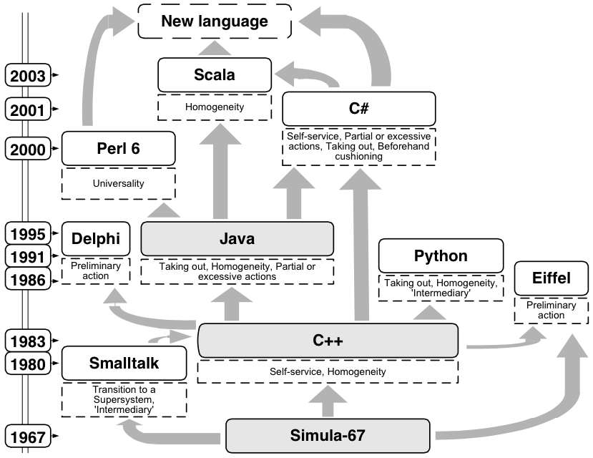
The Past

Slide 4


The Future

Slide 5
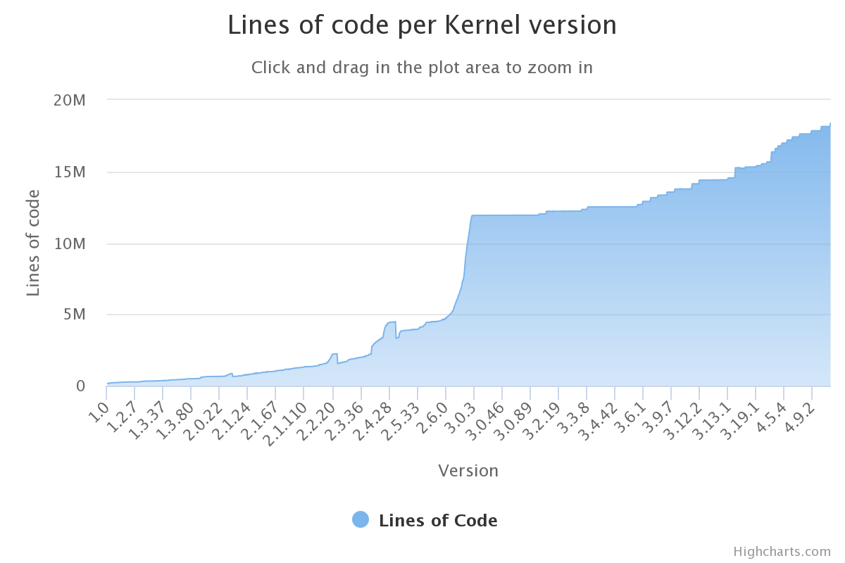
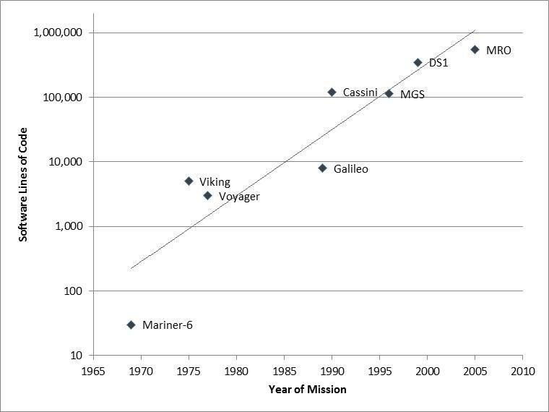
Software Size

Slide 6
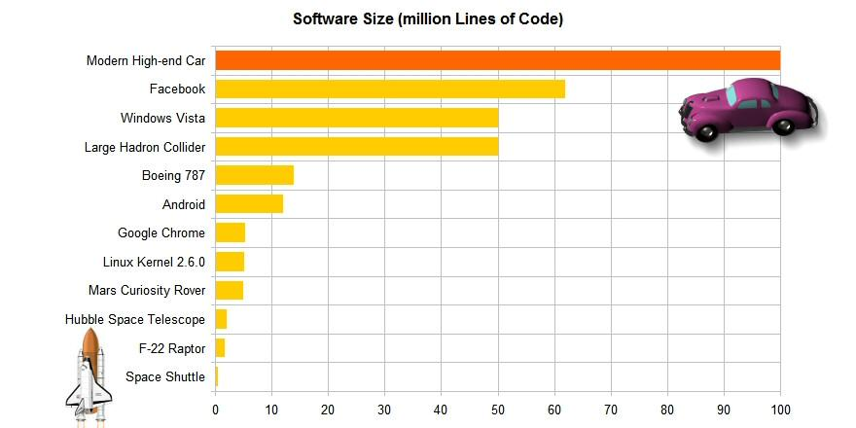
Software Size
http://www.informationisbeautiful.net/visualizations/million-lines-of-code/

Slide 7


Why OOP?

Slide 8
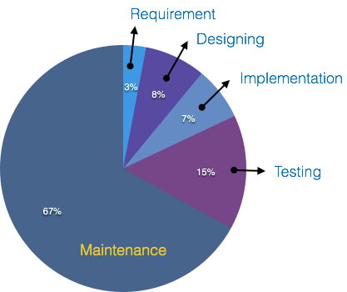
Why OOP?
Procedural programming languages (e.g., Pascal, C) are not suitable for building large software infrastructures
OOP addresses this issue and reduces development and maintenance costs for large and complex software projects
OOP aims at software being secure, re-usable, flexible, documentable, extensible
Instead of focusing on algorithms, optimization and efficiency, OOP focus on programming techniques
OOP considers software as a set of well-defined entities containing both data and functions

Slide 9
Why OOP? (Software crisis)
The causes of the software crisis were linked to the overall complexity of hardware and the software development process. The crisis manifested itself in several ways:
Projects running over-budget
Projects running over-time
Software was inefficient
Software was difficult to maintain
https://en.wikipedia.org/wiki/Software_crisis

Slide 10
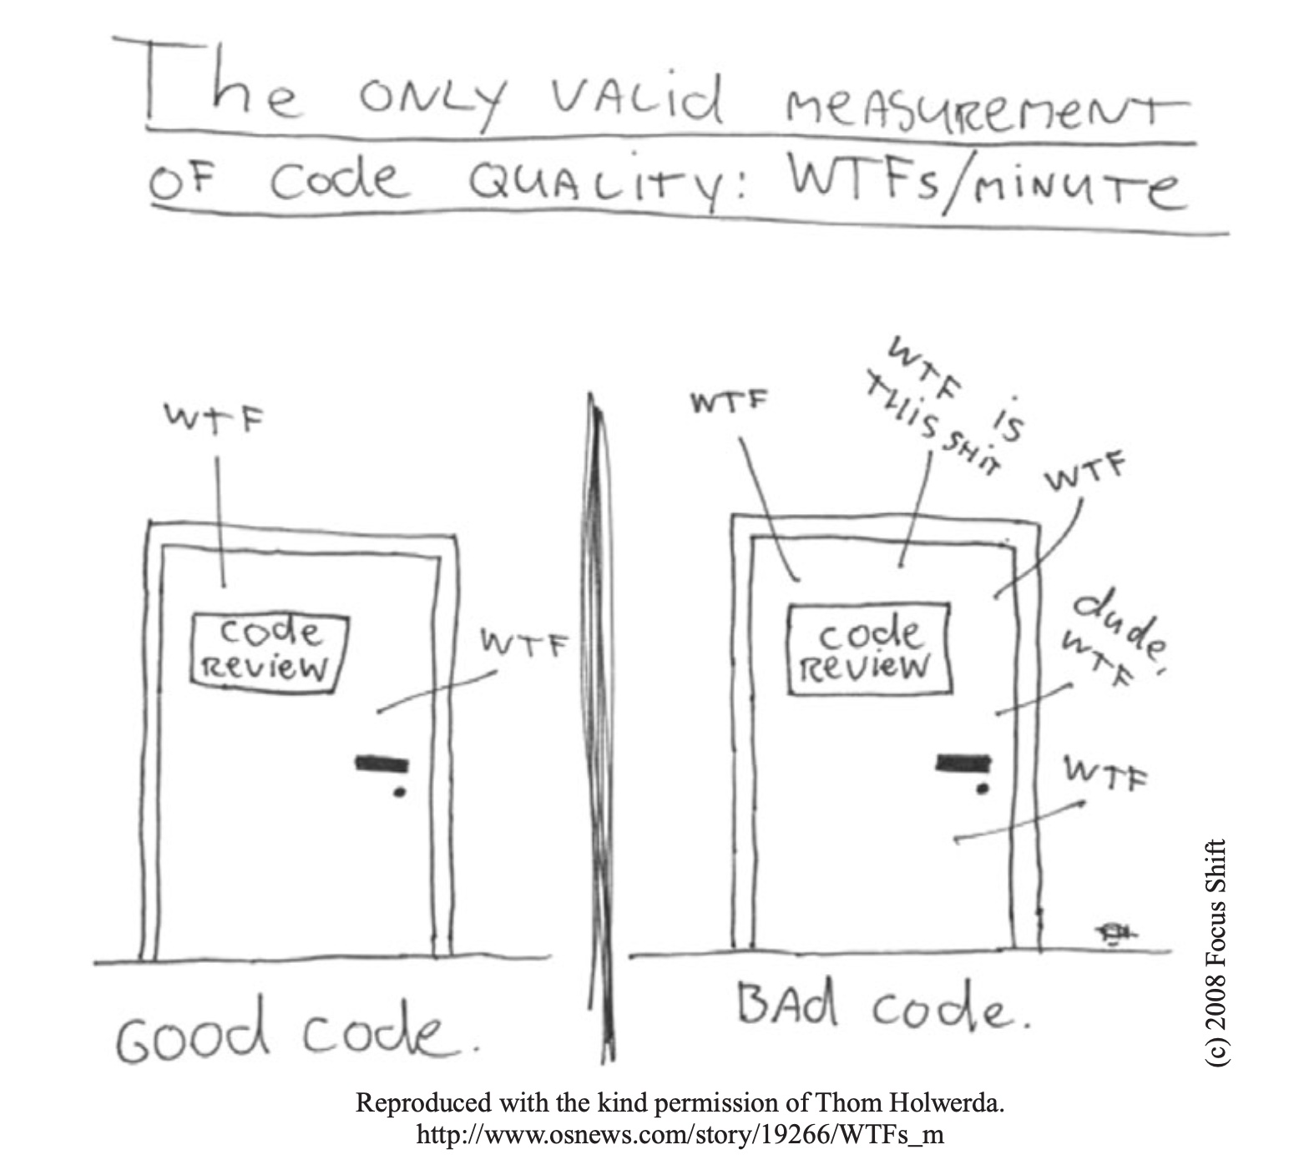
Errors / 1K SLOC
Industry Average
25 errors / 1K SLOC
Corporate Applications
5 errors / 1K SLOC
Cleanroom development technique
0.5 errors / 1K SLOC

Slide 11
Fuctions vs Objects

Slide 12
Procedural Programming
#include <stdio.h> #include <stdlib.h> void init(int v[], int size) {
int i;
for (i = 0; i < size; i++) {
v[i] = rand() % 100;
}
}
void sort(int v[], int n) {
int i, j, tmp, changed;
for (i = 0; i < n-1; i++) {
changed = FALSE;
for (j = 0; j < n - i - 1; j++) {
if (v[j] > v[j + 1]) {
changed = TRUE;
tmp = v[j];
v[j] = v[j + 1];
v[j + 1] = tmp;
}
}
if (!changed) break;
}
}
int search(const int v[], int size, int value) {
int i;
for (i = 0; i < size; i++ ) {
if (v[i] == value) {
return i;
}
}
return -1;
}
void show(int v[], int size) {
int i;
for (i = 0; i < size; i++) {
printf("[%d] %d\n", i, v[i]);
}
}
int main() {
int v[100];
int n = sizeof(v) / sizeof(v[0]);
init(v, n);
sort(v, n);
search(v, n, 10);
}

Slide 13
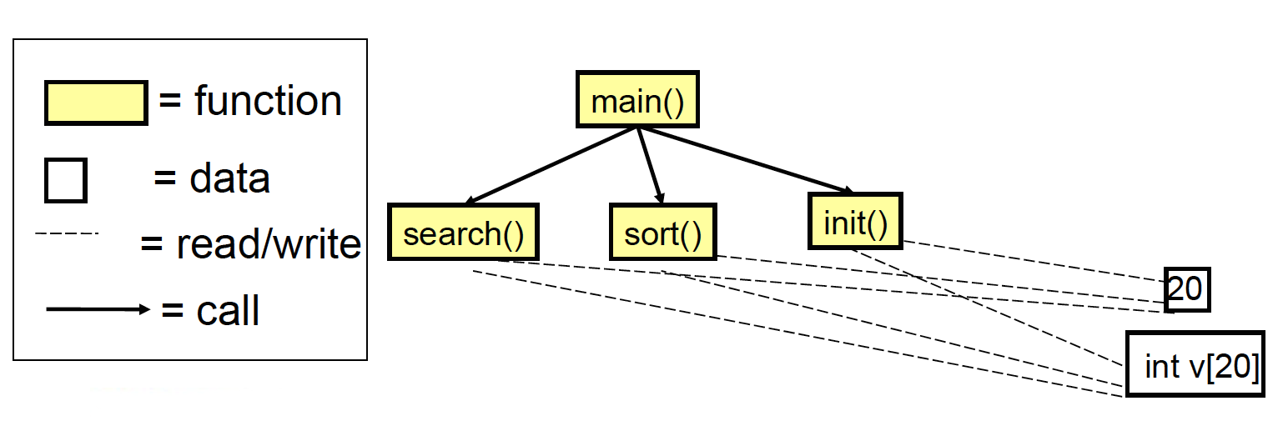
Modules and relationships

Slide 14
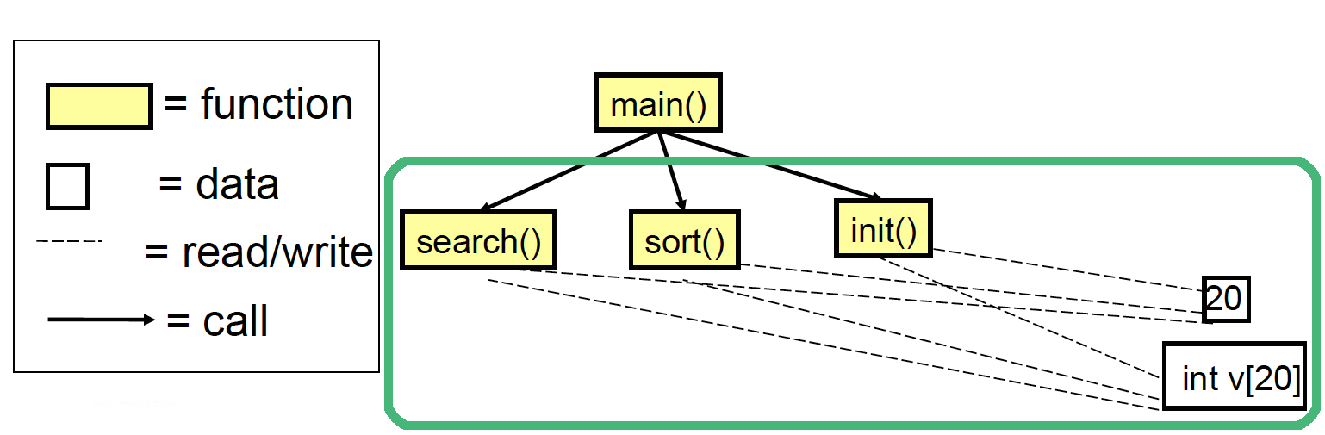
Issues
No clear relationship between
The actual array (int v[20])
Operations on the array (search(), sort(), init())
Need of a dedicated variable for storing the array size
int v[100]; int n = sizeof(v) / sizeof(v[0]);
Initialization not guaranteed

Slide 15
Issues
Reuse of code limited
Data and operations are separate. This makes it complex to reuse existing code in other projects
Data protection limited
Unprotected data accessible from vast portions of the source code. After a certain stage, debug becomes a nightmare!
Decomposition limited
Large scale projects require a large scale working force (many teams). Unprotected data, separate from operations, makes it hard to decompose

Slide 16
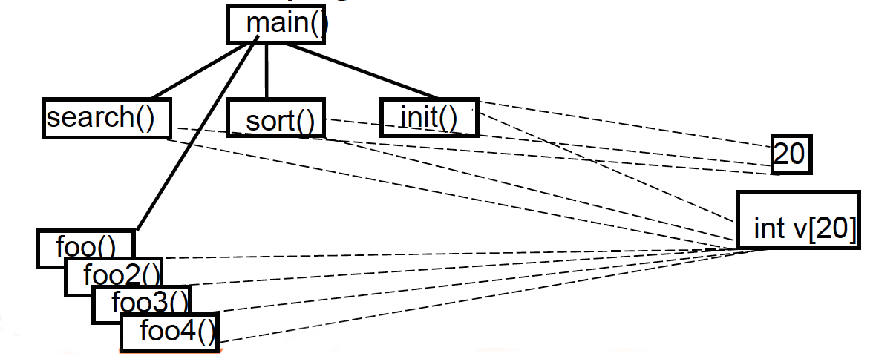
Issues in the long run
External functions can also use array’s data, leading to a growing number of relationships over time
Source code becomes difficult to understand and maintain (spaghetti code)

Slide 17
Solution!
Define a primitive concept (a special vector) in which data and operations are modularized together!

Slide 18
Object-Oriented approach
public class Vector {
int[] v;
public Vector(int capacity) {
this.v = new int[capacity];
init();
}
void sort() {
boolean changed;
for (int i = 0; i < v.length-1; i++) {
changed = false;
for (int j=0; j < v.length - i - 1; j++) {
if (v[j] > v[j + 1]) {
changed = true;
int tmp = v[j];
v[j] = v[j + 1];
v[j + 1] = tmp;
}
}
if (!changed) break;
}
}
void init() {
Random rnd = new Random();
for (int i = 0; i < v.length; i++) {
v[i] = rnd.nextInt(100);
}
}
int search(int value) {
for (int i = 0; i < v.length; i++) {
if (v[i] == value) {
return i;
}
}
return -1;
}
void show() {
for (int i = 0; i < v.length; i++) {
System.out.printf("[%d] %d\n", i, v[i]);
}
}
}

Slide 19
Object-Oriented approach
int main() {
int v[100];
int n = sizeof(v) / sizeof(v[0]);
init(v, n);
sort(v, n);
search(v, n, 10);
}
public static void main(String[] args) {
Vector v1 = new Vector(20);
Vector v2 = new Vector(30);
v1.sort();
v1.show();
v1.search(10);
}

Slide 20
OOP Engineering Approach

Slide 21
An engineering approach
OOP implies a shift to a client-server model
Do not uses functions for processing data
Ask entities to deliver services using internal data
operation(object, params)
For example:
search(vector, value)
object.operation(params)
For example:
vector.search(value)

Slide 22
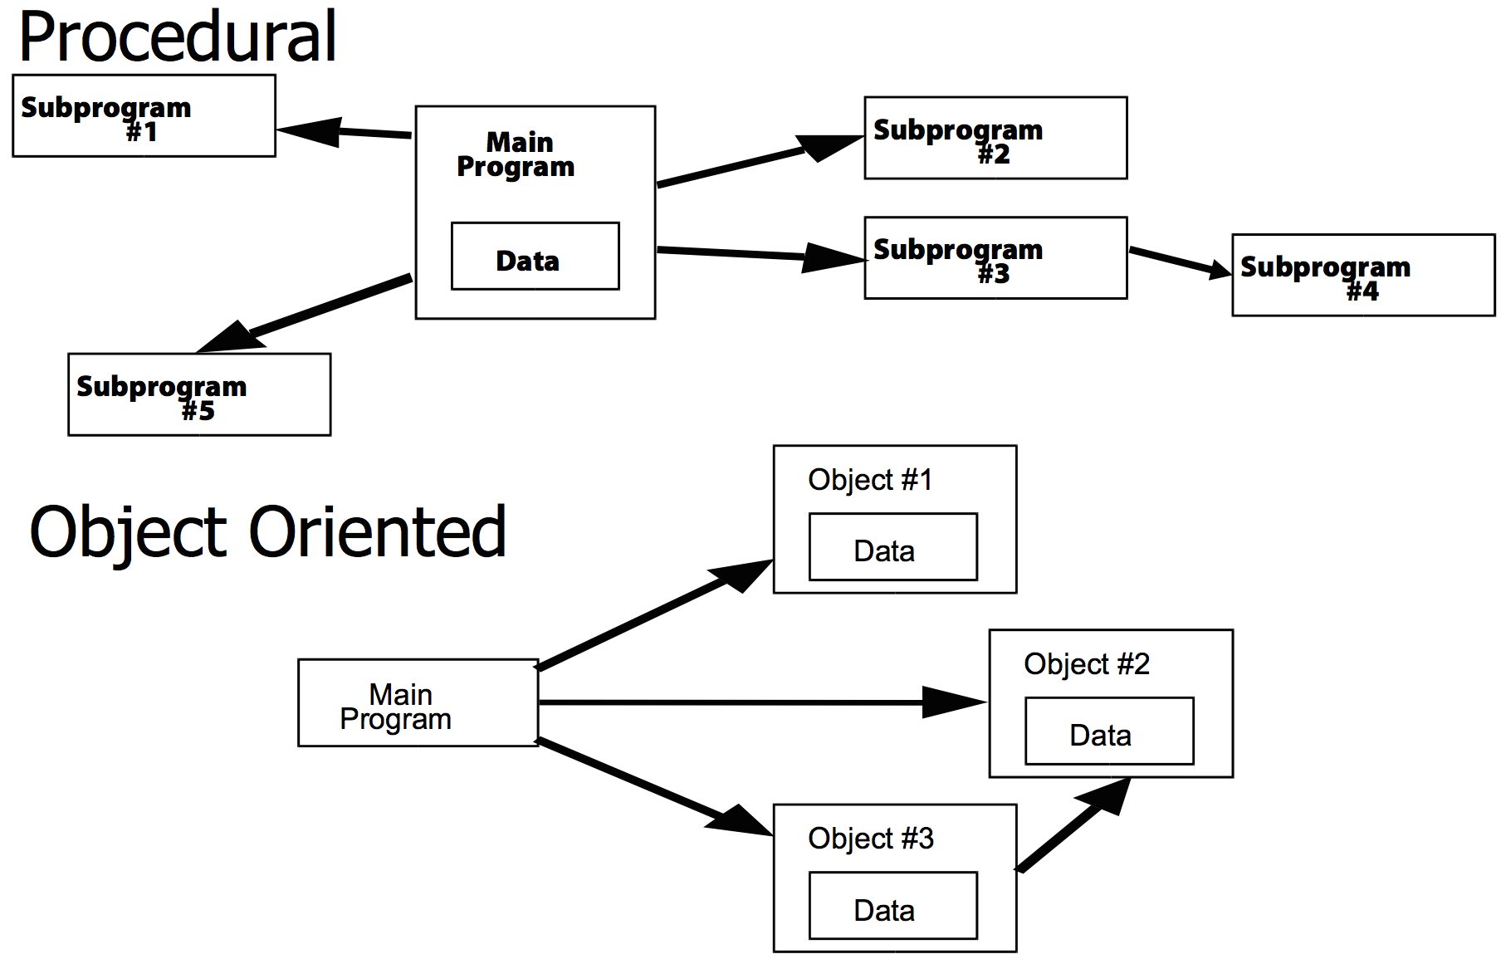
An engineering approach

Slide 23
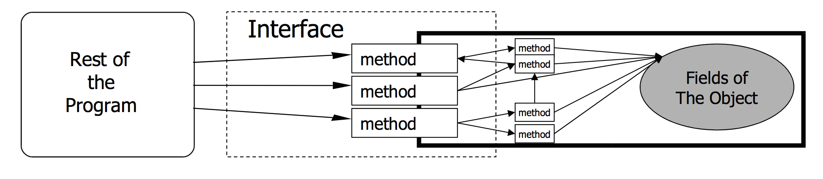
An engineering approach
Given an object oriented program, we have to:
Identify the needed components
Define component interfaces
Define how components interact each other through their interface

Slide 24
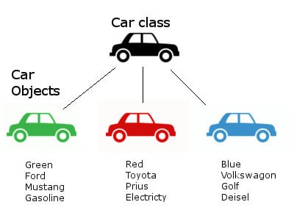
Classes and objects
public class Car {
String color;
String brand;
String model;
String fuel;
public Car(color, brand, model, fuel) {
this.color = color;
this.brand = brand;
this.model = model;
this.fuel = fuel;
}
/* ... */
}
Car c1 = new Car(Green, Ford, Mustang, Gasoline);
Car c2 = new Car(Red, Toyota, Prius, Electricity);
Car c3 = new Car(Blue, VW, Golf, Diesel);

Slide 25
Classes and objects
Class (the description of objects’ structure):
Data (ATTRIBUTES)
Operations (METHODS)
Object (class instance)
Identity
Type
Internal state
A class is like a type definition. No data is allocated until an object is created from the class
The creation of an object is called instantiation. The created object is often called an instance
No limit to the number of objects that can be created from a class
Each object is independent. Changing one object doesn't change the others

Slide 26
OOP Key Features
Encapsulation
Inheritance
Polymorphism

Slide 27
Encapsulation

Slide 28
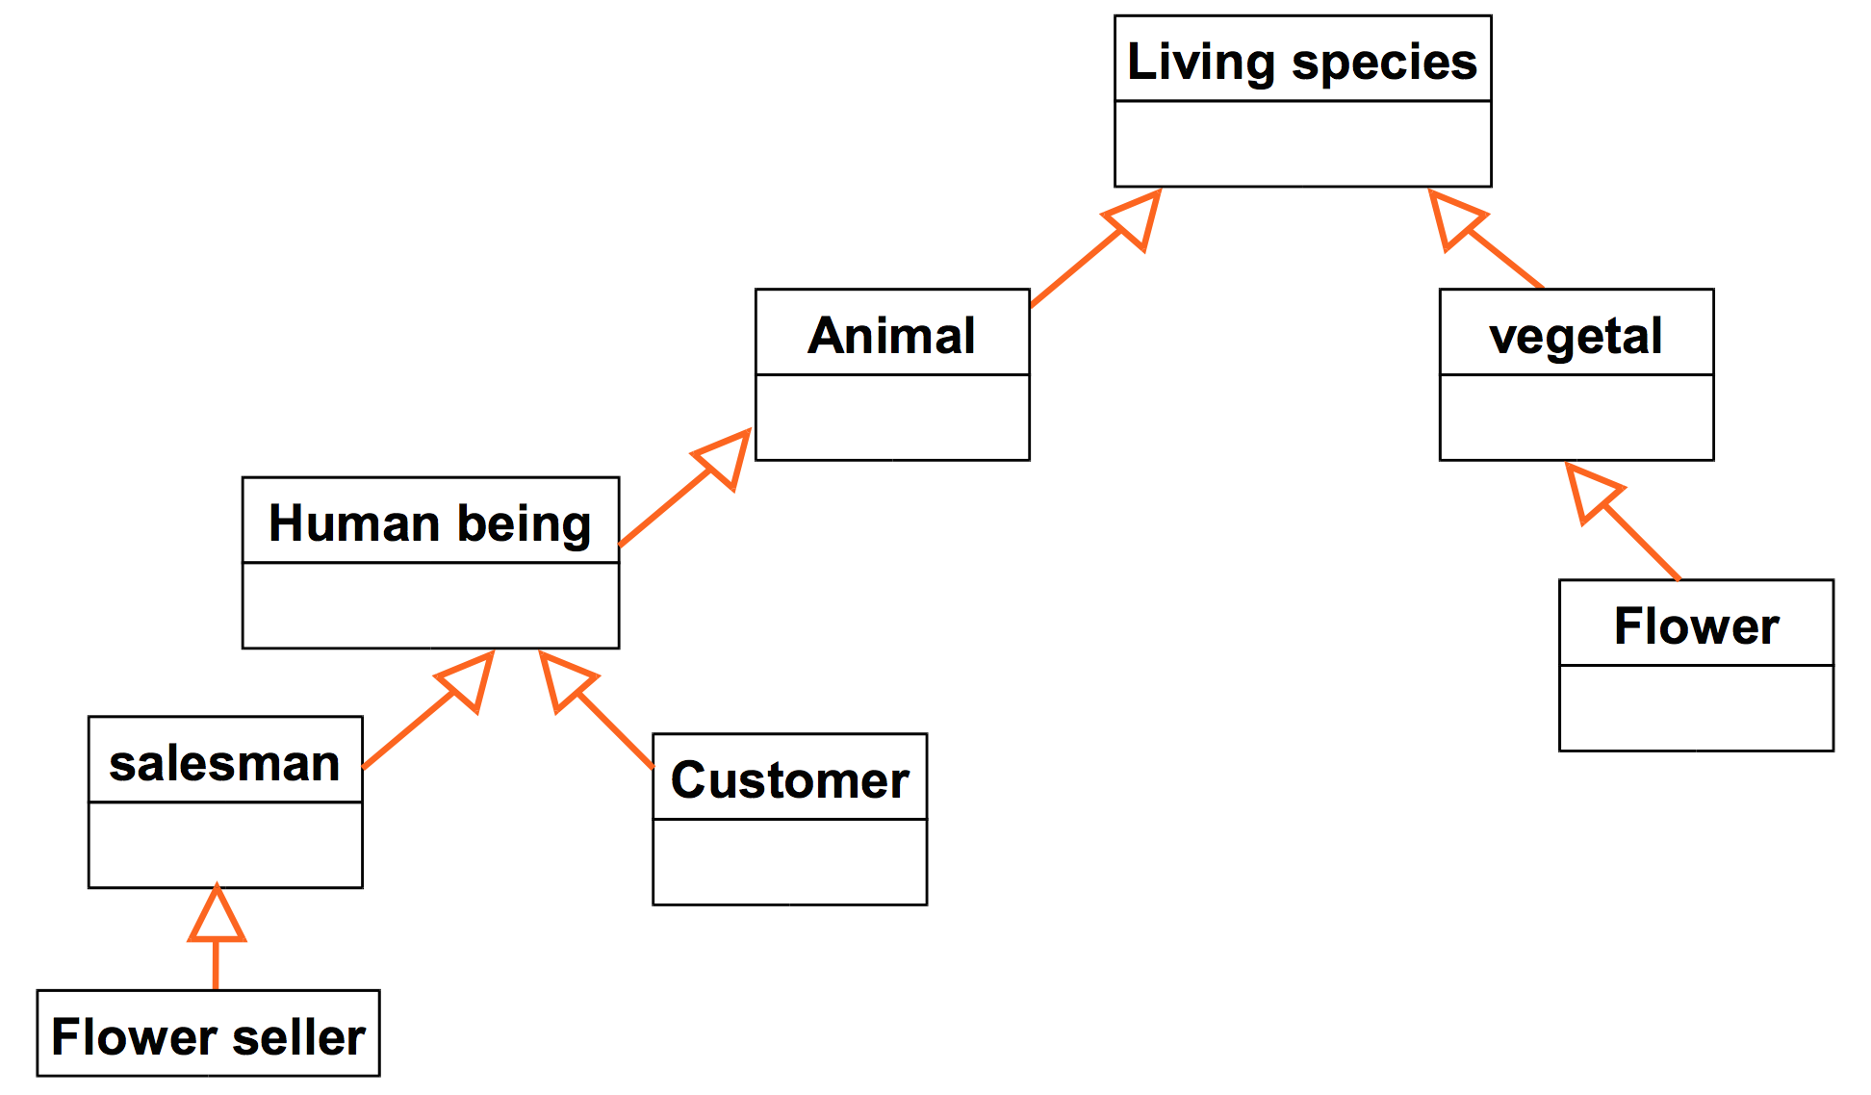
Inheritance

Slide 29
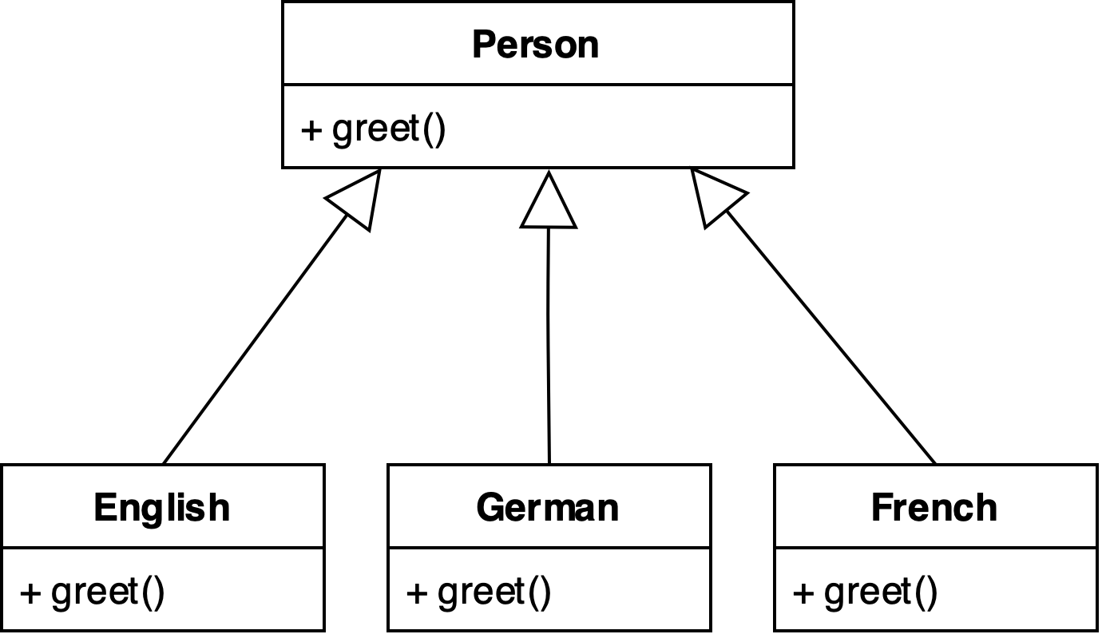
Polymorphism

Slide 30
Advantages of OOP
Cooperative development
Different people working on different classes
Code management
Bugs on object data are easy to spot. Since data are not visible from the outside, errors mostly occurs in the object handling the data
Changes on a specific class do not impact other classes (unless external interface is modified)
Incremental design and development
Define new classes by extending the exsisting ones

Slide 31
Disadvantages of OOP
Needs a Object Oriented way of thinking
Complex design (e.g., Which classes?, How many classes?)
Benefits only occur in large programs
Programs < 100 lines, spaghetti is understandable and faster to write
Programs > 1K lines, spaghetti is incomprehensible, not maintainable

Slide 32
Wisdom Pills
Learning to write clean code is hard work. It requires more than just the knowledge of principles and patterns. You must sweat over it. You must practice it yourself, and watch yourself fail. You must watch others practice it and fail. You must see them stumble and retrace their steps. You must see them agonize over decisions and see the price they pay for making those decisions the wrong way. -- Clean Code, Robert C. Martin

